Slide 1
AUTOMATIC GENERATION CONTROL

Slide 2
INTRODUCTION
Automatic generation control (AGC) is a system for adjusting the power output of multiple generators at different power plants, in response to changes in the load
The main objective of power system operation and control is to maintain continuous supply of power with an acceptable quality, to all the consumers in the system.
The system will be in equilibrium, when there is a balance between the power demand and the power generated. As the power in AC form has real and reactive components: the real power balance; as well as the reactive power balance is to be achieved.
There are two basic control mechanisms used to achieve reactive power balance (acceptable voltage profile) and real power balance (acceptable frequency values).
1) Automatic voltage regulator (AVR) and
2) Automatic load frequency control (ALFC) or automatic generation control (AGC)

Slide 3
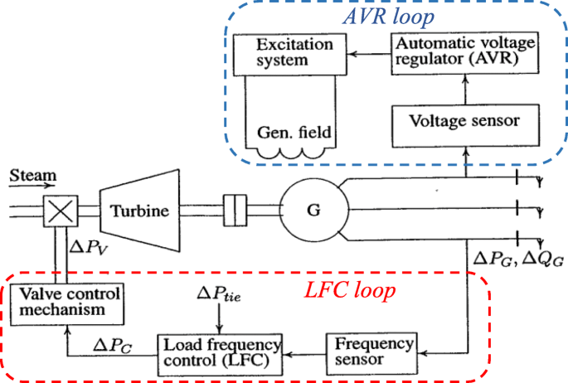

Slide 4
Generator Voltage Control System
The voltage of the generator is proportional to the speed and excitation (flux) of the generator. The speed being constant, the excitation is used to control the voltage. Therefore, the voltage control system is also called as excitation control system or automatic voltage regulator (AVR).
For the alternators, the excitation is provided by a device (another machine or a static device) called exciter.
For a large alternator the exciter may be required to supply a field current of as large as 6500A at 500V and hence the exciter is a fairly large machine. Depending on the way the dc supply is given to the field winding of the alternator (which is on the rotor), the exciters are classified as:
i) DC Exciters;
ii) AC Exciters; and
iii) Static Exciters.
Accordingly, several standard block diagrams are developed by the IEEE working group to represent the excitation system. A schematic of an excitation control system is shown

Slide 5
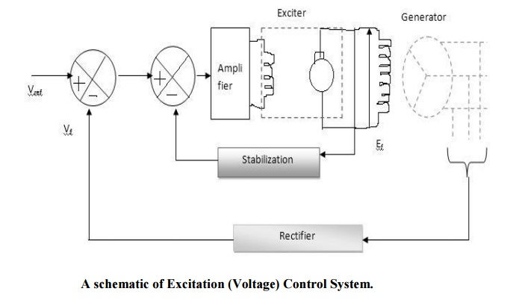

Slide 6
Automatic Load Frequency Control:
The ALFC is to control the frequency deviation by maintaining the real power balance in the system.
The main functions of the ALFC are to
i) to maintain the steady frequency;
ii) control the tie-line flows; and
iii) distribute the load among the participating generating units.
The control (input) signals are the tie-line deviation ∆Ptie (measured from the tie line flows), and the frequency deviation ∆f (obtained by measuring the angle deviation ∆δ). These error signals ∆f and ∆Ptie are amplified, mixed and transformed to a real power signal, which then controls the valve position. Depending on the valve position, the turbine (prime mover) changes its output power to establish the real power balance.

Slide 7
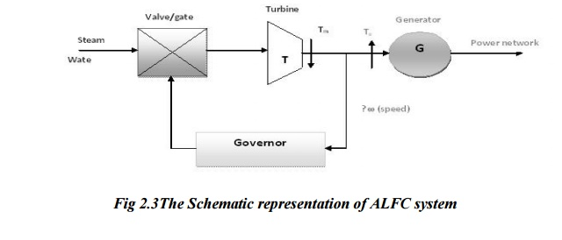

Slide 8
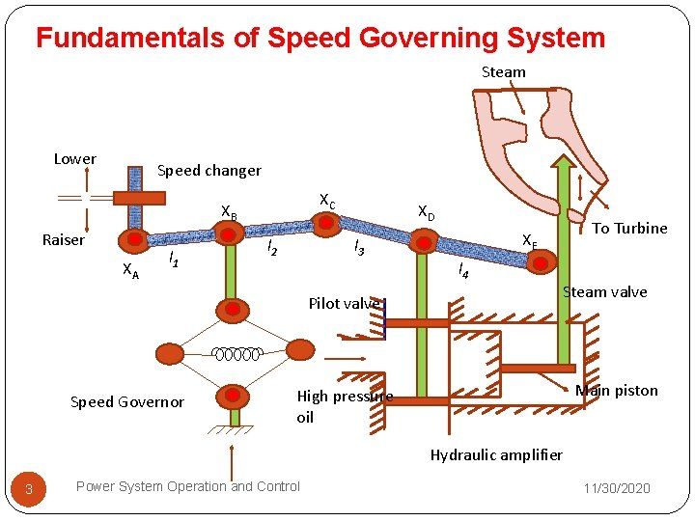
Speed Governing Mechanism and Modelling

Slide 9
The speed governing mechanism includes the following parts.
Speed Governor:
It is an error sensing device in load frequency control. It includes all the elements that are directly responsive to speed and influence other elements of the system to initiate action.
Governor Controlled Valves:
They control the input to the turbine and are actuated by the speed control mechanism.
Speed Control Mechanism:
It includes all equipment such as levers and linkages, servomotors, amplifying devices and relays that are placed between the speed governor and the governor controlled valves.
Speed Changer:
It enables the speed governor system to adjust the speed of the generator unit while in operation.

Slide 10
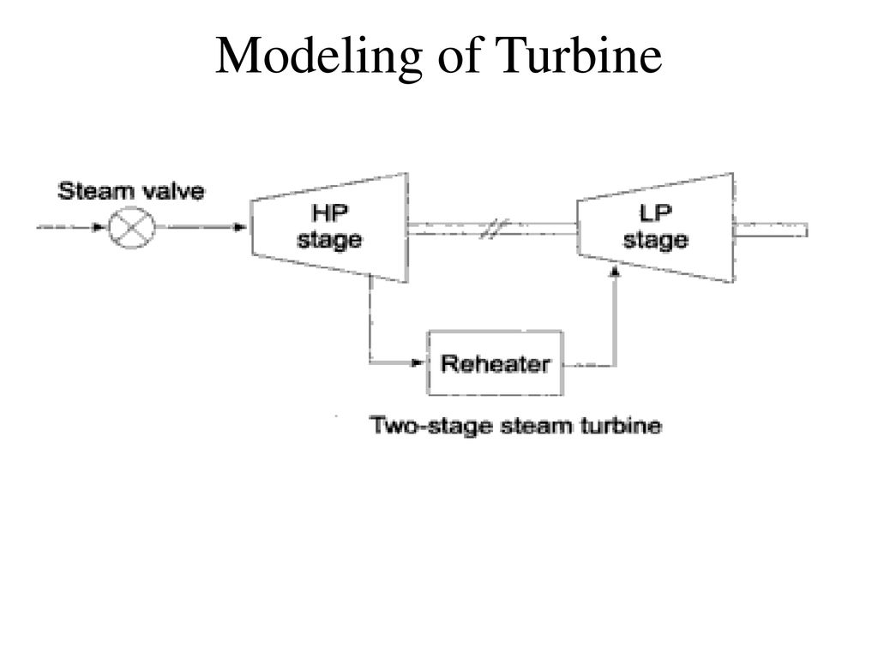

1. MATHEMATICAL MODELLING OF A TURBINE/Turbine model
The prime mover driving a generator unit may be a steam turbine or a hydro turbine.
The models for the prime mover must take account of the steam supply and boiler control system characteristics in the case of steam turbine on the penstock for a hydro turbine
The dynamic response of steam turbine in terms of changes in generator power output ΔP_{G} to change in steam valve opening ΔX_{E}

Slide 11


2. Generator load or Power system model
To develop the mathematical model of an isolated generator, which is only supplying local load and is not supplying power to another area,
Suppose there is a real load change of ΔP_{D} .
Due to the action of the turbine controllers, the generator increases its output by an amount ΔP_{G} .
The net surplus power (ΔP_{G} - ΔP_{D} ) will be absorbed by the system in two ways.
By increasing the kinetic energy in the rotor at the rate
As the frequency changes, the motor load changes being sensitive to speed, the rate of change of load w.r.t frequency f

Slide 12



Slide 13
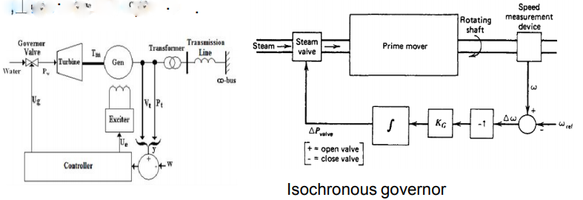
Isochronous governor
an integral controller resulting in constant speed regardless of the load or generators maintain a constant frequency
not suitable for multimachine systems (is isolated machine or non-coherent machine) ; slight differences in speed settings would cause them to fight or conflict against each other (since is not connected at same shaft)
can be used only when a generator is supplying an isolated load or when only one generator in a system is required to respond to load changes

Slide 14
Governor with Speed Droop/modelling of governor
The isochronous governors cannot be used when there are two or more units connected to the same system since each generator would have to precisely the same speed setting.
For stable load sharing between two or more units operating in parallel, the governors are provided with a characteristics so that the speed drops as the load in increased.
speed regulation or droop is provided to assure proper load sharing
a proportional controller with a gain of 1/R
The speed-load characteristic can be adjusted by changing governor settings; this is achieved in practice by operating speed-changer motor

Slide 15
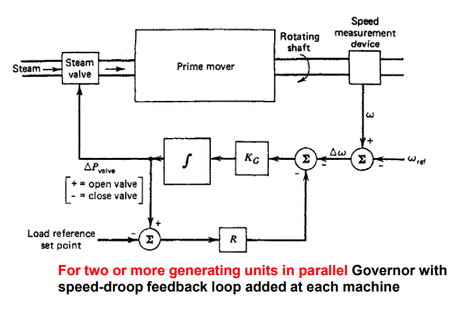
To be able to run two or more generating units in parallel on a generating system, the governors are provided with a feedback signal that causes the speed error to go to zero at different values of generator output.
This can be accomplished by adding a feedback loop around the integrator as shown in figure where the governor now has a net gain of l/R and a time constant TG

Slide 16
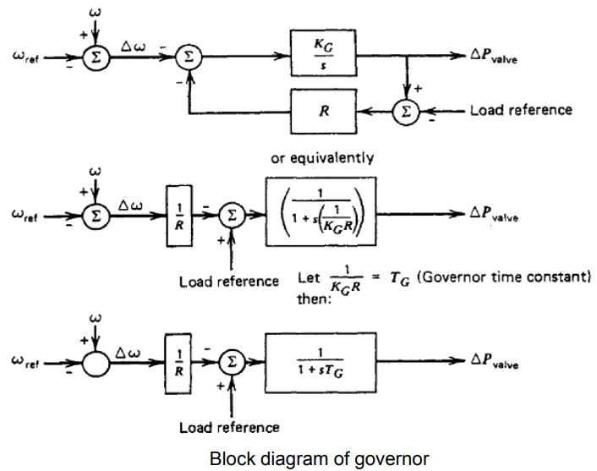
Figure shows an input labeled "load reference set point." By changing the load reference, the generator's governor characteristic can be set to give reference frequency at any desired unit output.

Slide 17


3. Speed Governor modal
The governor compensates for changes in the shaft speed
changes in load will eventually lead to a change in shaft speed
change in shaft speed is also seen as a change in system frequency
So, from block diagram of governor, we redraw governor model

Slide 18
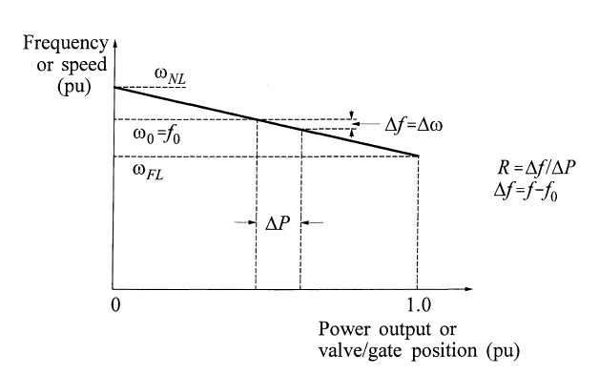
Speed-droop characteristic(R)
The result of adding the feedback loop with gain R is a governor characteristic as shown in Fig. The value of R (speed slope) determines the slope of the characteristic. Where R determines the change on the unit's output for a given change in frequency.
The value of R determine the steady state speed versus load characteristics of generating unit.
The ratio of speed deviation(Δω) or frequency deviation (Δf) to change in valve/gate position (ΔY) or power output (ΔP) is equal to R.

Slide 19
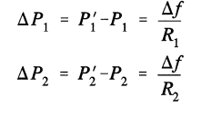

Paralleled generators sharing active power of load
If two or more generators with drooping governor characteristics are connected to a power system, there will be a unique frequency at which they will share a load change
They are initially at nominal frequency f₀,with outputs P₁ and P₂.
When a load increases ΔP_{L} causes the units to slow down, the governors increase output until they reach a new common operating frequency f’.
The amount of load picked up by each unit depends on the droop characteristics:
Hence
If the percentage of regulation of the units are nearly equal, the change in the outputs of each unit will be nearly in proportion to its rating

Slide 20
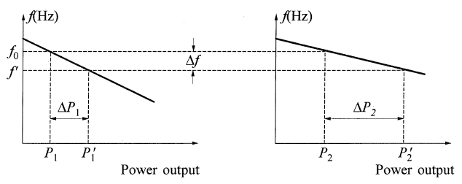

Slide 21
5. OVER ALL Model of Load frequency control of single area / block diagram representation of isolated system
Speed Governor
Turbine
Power system
Complete Block diagram representation of LFC

Slide 22
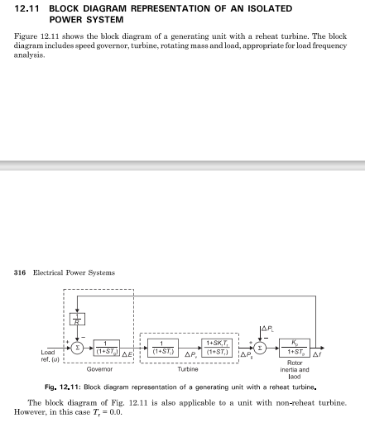

Slide 23
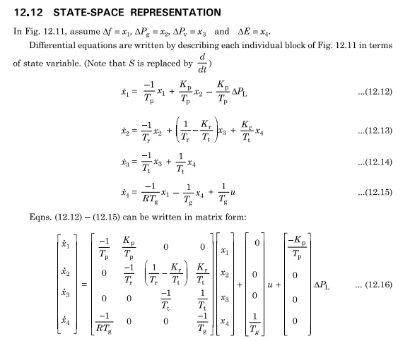

Slide 24
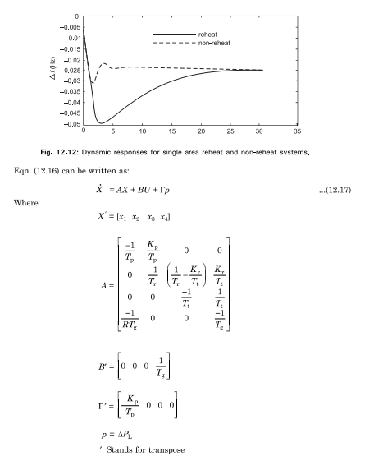

Slide 26
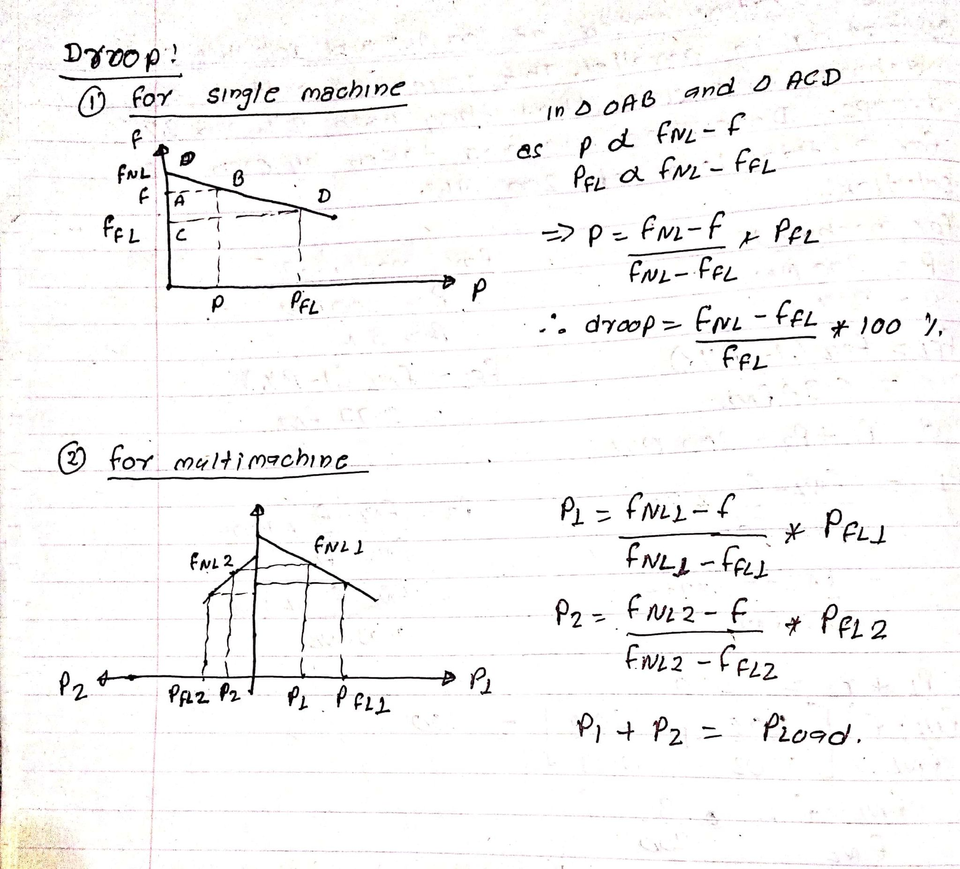

Slide 27
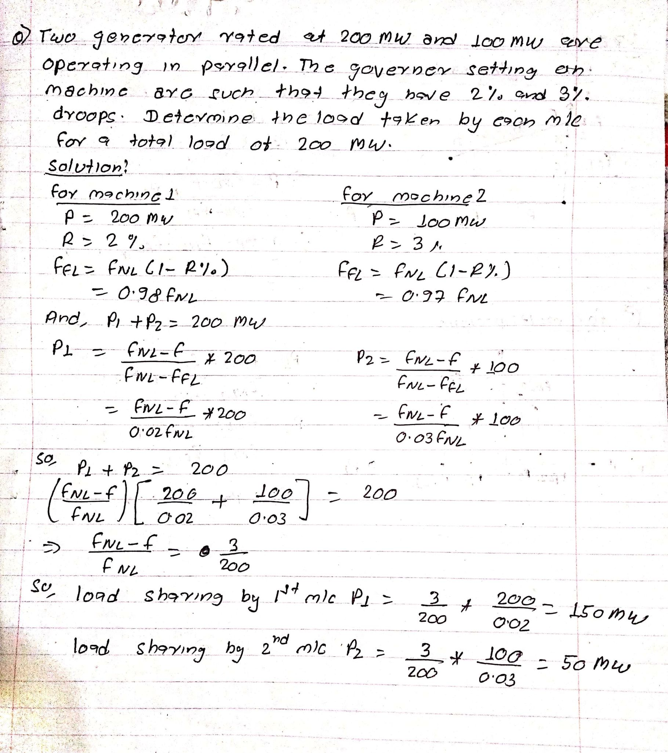

Slide 28
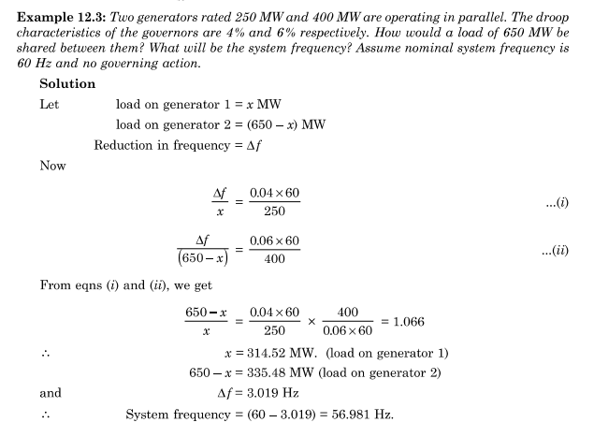

Slide 29
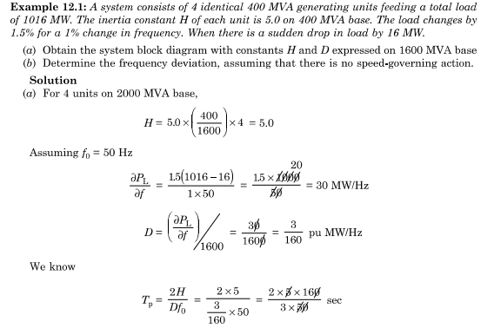

Slide 30
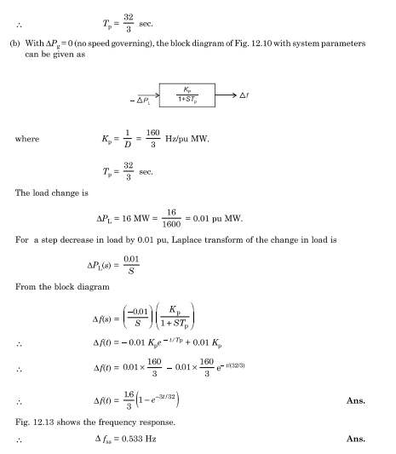

Slide 31
